Slide 1
NYPD COMPLAINTS DATA ANALYSIS
HANMISHA VODDINENI
HRUSHI PATEL

Slide 2
INTRODUCTION:
The goal of this project is to clean the data in a dataset, analyze it and provide a descriptive summary.
We have considered NYPD Complaint data historic dataset from NYC Open Data. This dataset contains includes all valid felony, misdemeanor, and violation crimes reported to the New York City Police Department.
The main step before beginning the project is project formulation where we take the raw data (which includes incorrect, inaccurate and incomplete data) and look for data quality issues.
Project is done using PySpark.

Slide 3
MAIN STEPS
Data Preprocessing
a) Data Profiling
b) Data Cleaning
Data Processing
Data Visualization

Slide 4
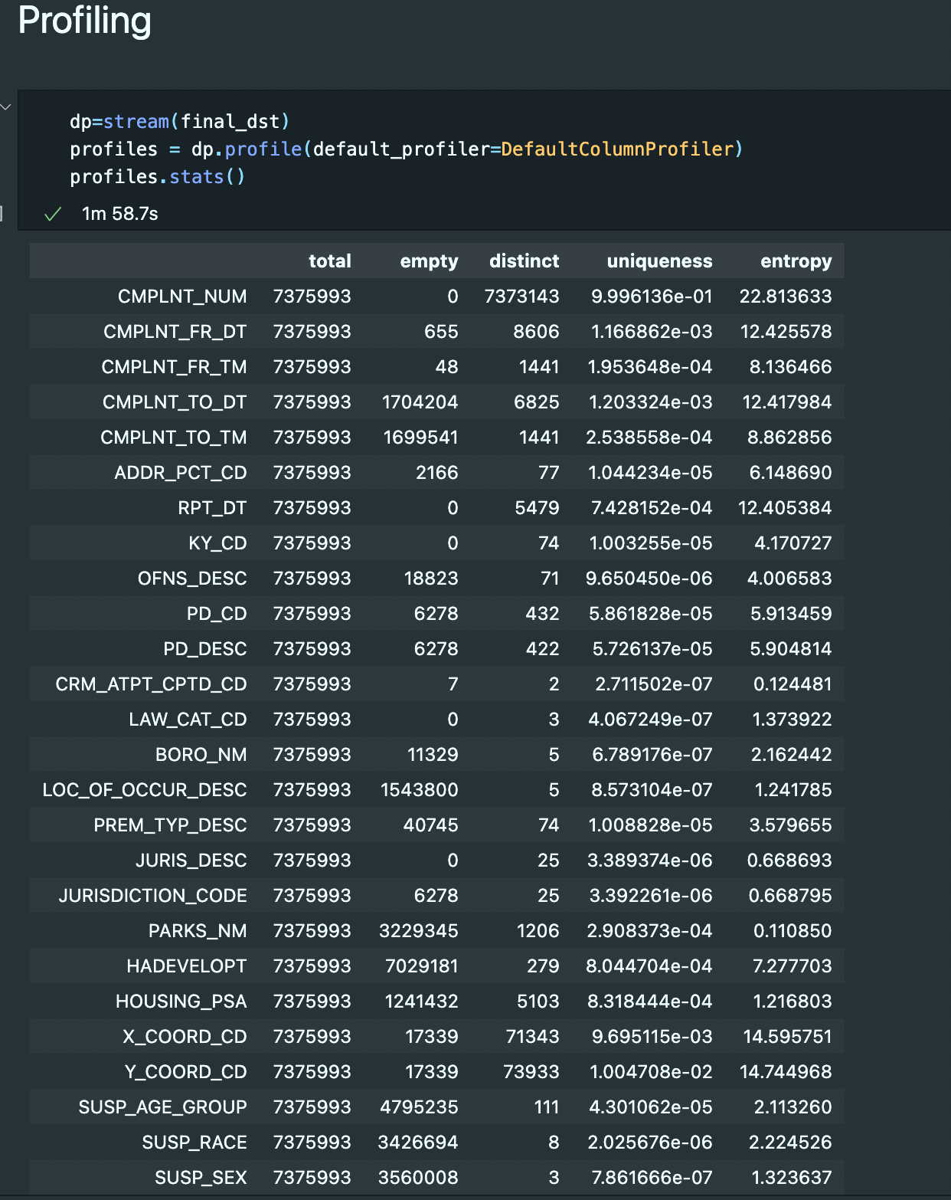
DATA PREPROCESSING
Data Profiling
We have used open clean library for data profiling.
Data preparation requires profiling to gain an understanding of data quality issues, and data manipulation to transform the data into a form that is fit for the intended purpose.

Slide 5
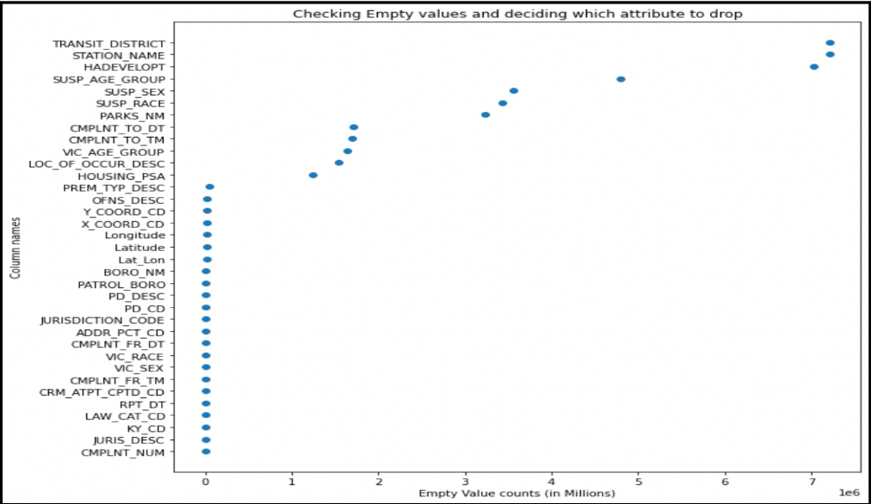
DATA CLEANING
The main objective of this step is to identify the columns with empty values and extract the most meaningful ones.
Created a scatter plot visualization with column names on the x axis and empty values count on the y axis.
Transit_District, Station_Name has the most empty values.
We have identified 23 columns have the 0 empty values columns out of 35.

Slide 6
DATA PROCESSING
Finding data discrepancies is essential for further analysis because outliers can wildly cause misinterpretation of the analysis we make.
We are explaining two parts of realization here, one is finding missing values and another is finding incorrect values.
We are validating the values and replacing it with meaningful data.
We have implemented some modules to fix the problems like Invalid age group, date format, time format etc and changed them into specific format.

Slide 7
DATA PROCESSING
Invalid age group: If the values in the raw dataset are negative or an incorrect integer, replaced these incorrect values with meaningful values.
Invalid time format: If there is any Improper formatting for time . Using the combination of time and string manipulation to extract values that did not conform to the 24-hour format and formatted it.
Bound the coordinates to NYC: We found the bounding latitude and longitude values of New York City and removed values that do not fall within the city coordinates.
Validate Borough Names: Here, we check the validity of boroughs where the incident occurred as well as the patrol borough. We have replaced the abbreviated names with their full form.

Slide 8
VISUALIZATION
Data Exploration:
Exploratory analysis of data is one of the best forms to gather the architecture and dependencies within the data.
This can consist of various steps and charts that you can use to analyze data and explore connections and meanings between different data values present.
The aim here should be to thoroughly understand the working of tabular columns and the values they hold.

Slide 9
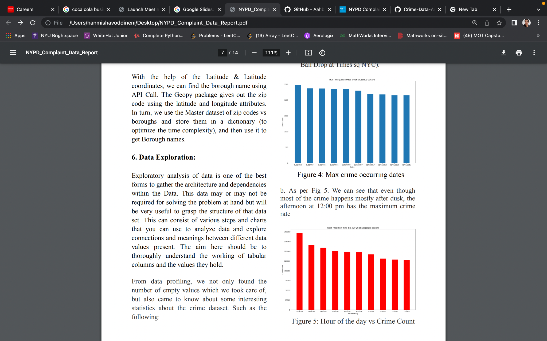
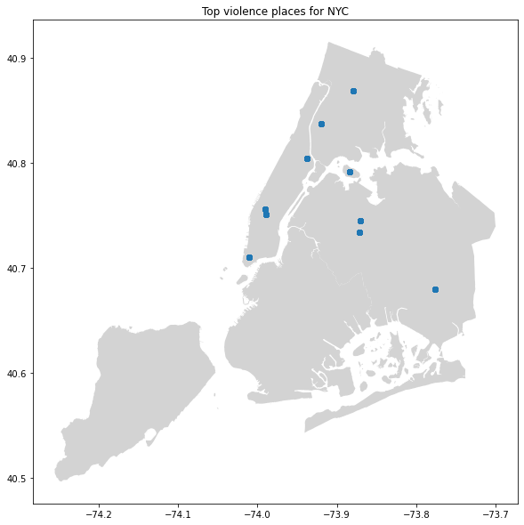
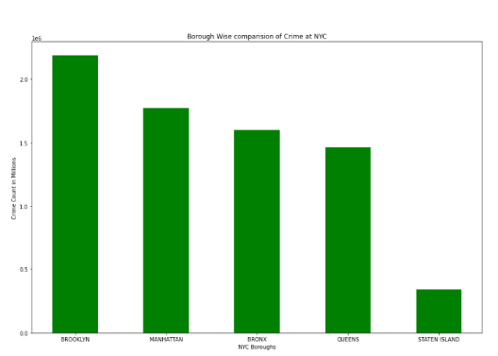
VISUALIZATION
Here we have 3 graphs to show crime rates based on dates, places,boroughs

Slide 10
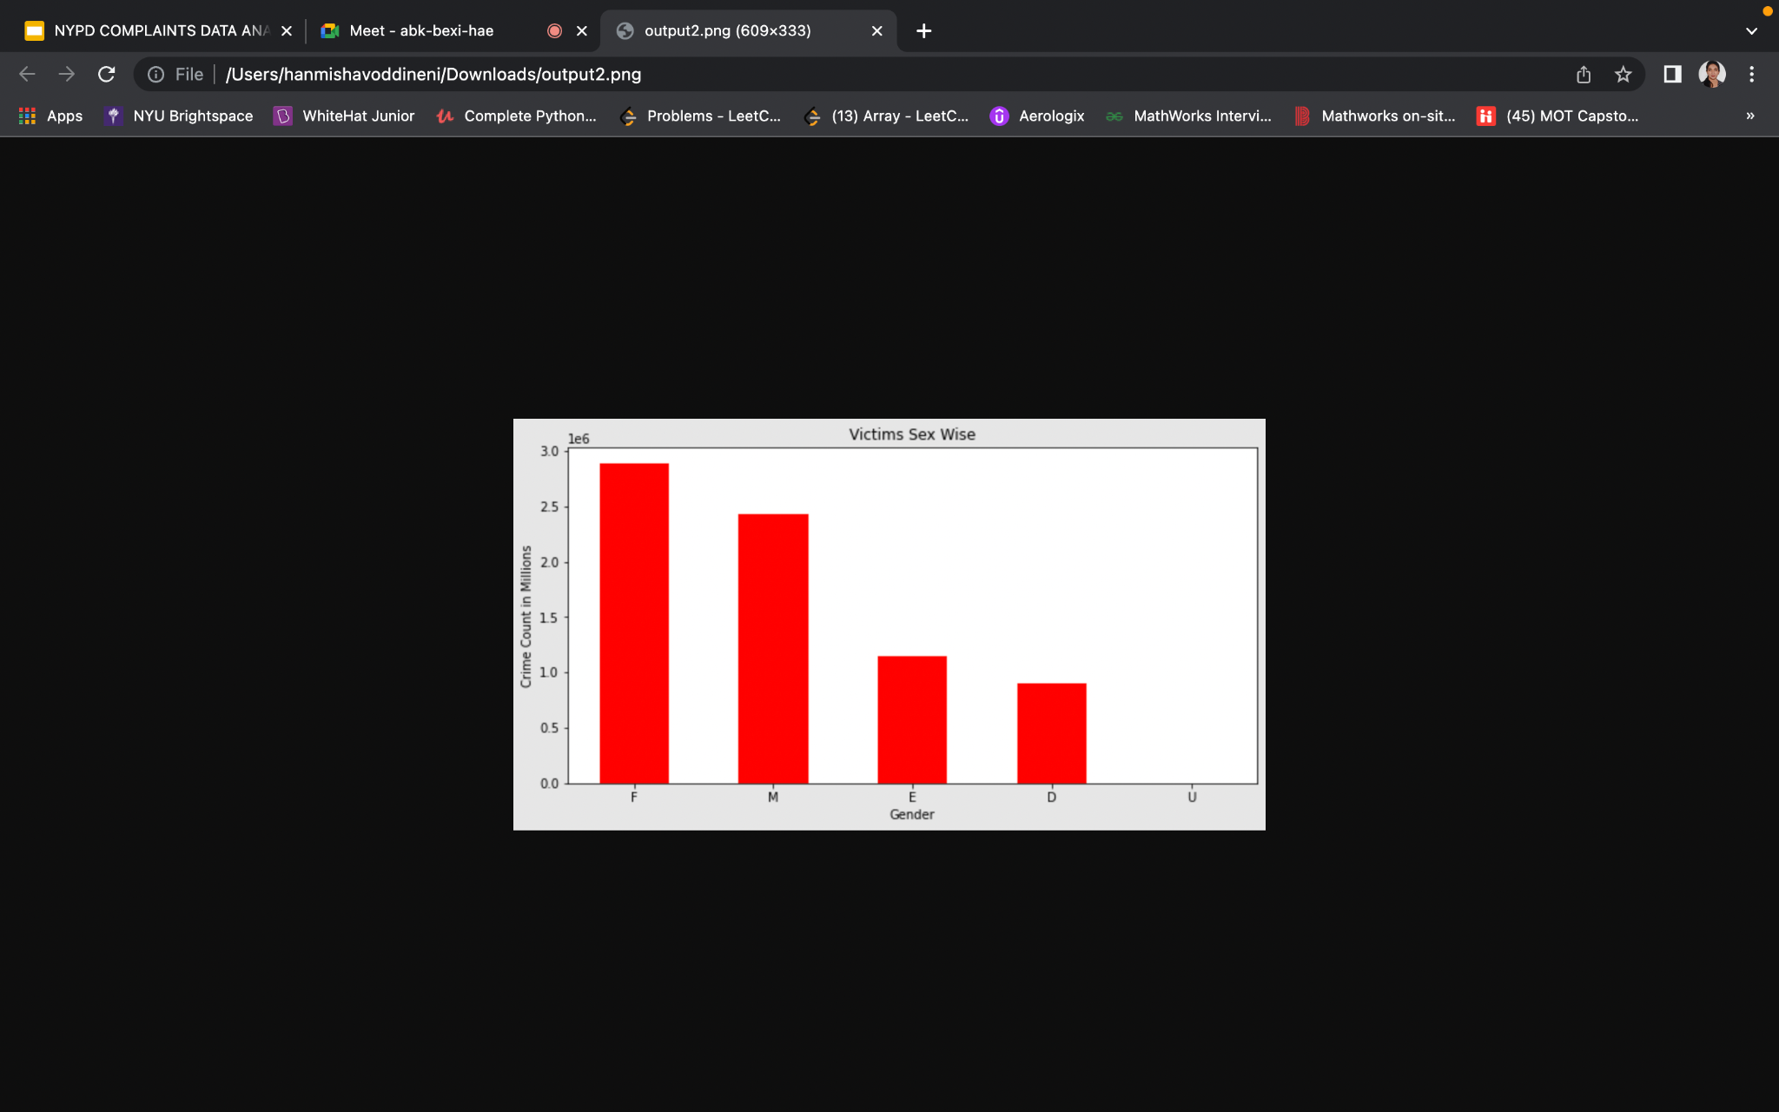
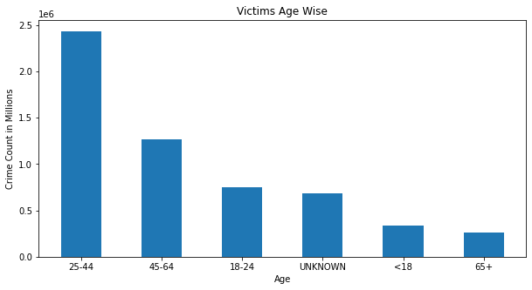
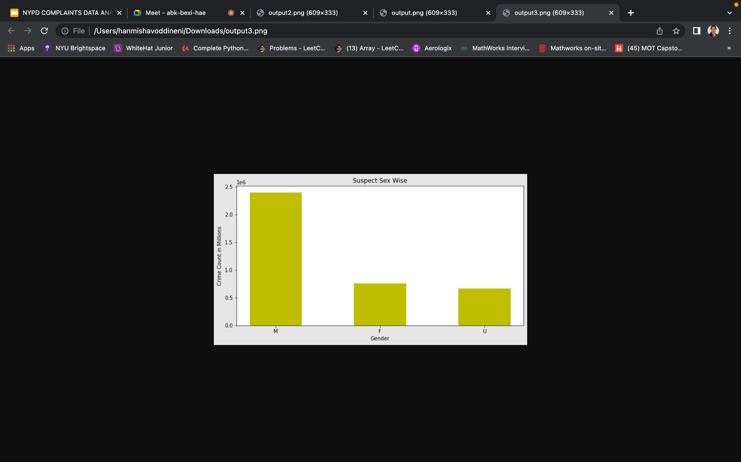
VISUALIZATION
Here we have 3 graphs to show crime rates based on gender, age

Slide 11
FUTURE WORKS AND SAVED DATA
The end data is saved and this can be used in different ways
This data can be use to visualize the data further and come up with reliable conclusions regarding which neighborhoods have the worst casualties, which dates had the most incidents, the relationship between the boroughs and crimes, etc.
By utilizing the cleaned data sets, one can suggest sensible patterns, visualizations about crimes in NYC, certain projections, and even relevant recommendations for policy-makers.

Slide 12
CONCLUSION
Data cleaning and data analysis plays an indispensable role in the knowledge discovery process of extracting interesting patterns or knowledge for understanding various phenomenons
By finding and understanding the discrepancies in the data we can suggest techniques that will help prospective researchers in analysing and exploring complaints filed.
Cleaned data can be used for civic action and policy change responsibly to expose the hidden patterns and ideologies

Slide 13


